Slide 1
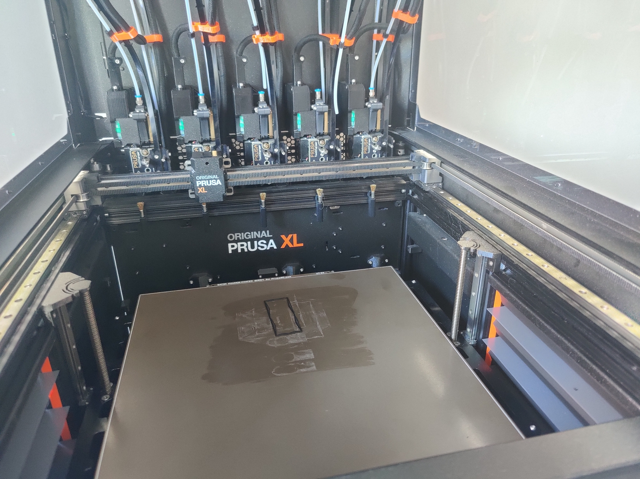
Bragg scattering based
Meta-structure

